Slide 1
Unit 1
Understanding academic English

Slide 2
CONTENTS
What is academic English?
Features of academic register.
Practice.

Slide 3
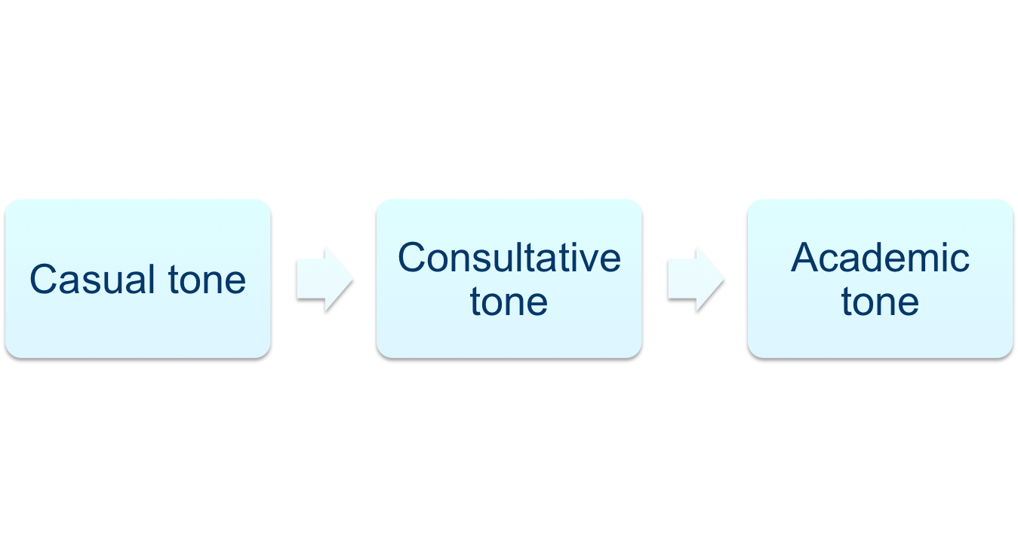
Pre-reading task 1
1. What is academic English? (p2 1.2)
Oral vs. written

Slide 4
Pre-reading task 2
2.What are the differences between general English and academic English (both are written English )?

Slide 5
Style 1.
Science has moved closer toward identifying the long -sought brain site of the "body clock”, the time that governs all the rhythms of life.
A Johns Hopkins University scientist has disclosed that a group of rats has been transformed by precision brain surgery from performing night activity into a complete reversal of their age- old timetable.
For thousands of years, the wild Norway rat has spent its day sleeping or hiding in deep holes and its nights outside searching for food and water as a means of surviving against predators.

Slide 6
Dr. Curt P. Richter, a noted psycho-biologist has developed a surgical means of destroying the animal's built- in clock ,in a special portion of the brain so that it spends most of the light hours being active and all of the dark hours sleeping .

Slide 7
Style 2
1.Low-dose heparin has been used as a prophylactic drug in general surgical patients but is flawed by the risk of sensitizing the patient to heparin and the development of DIC.
2.Radiolabeled fibrinogen studies demonstrate a reduction in the incidence of deep vein thrombosis to below 10 percent, and a subcutaneous regimen of 5000 units preoperatively and 12 hourly thereafter until the patient is mobile does not appear to cause excessive bleeding .
3.A pelvic and rectal examination must always be performed and should preferably be done by the surgeon or physician responsible for the complete assessment of the patient.

Slide 8
5. In the absence of symptoms, it is rare for a metastatic bone survey to identify metastatic disease in patients presenting with primary breast cancer who have a normal chest x-ray and only stage Ⅰ or Ⅱ disease.
6. Acute renal failure(ARF) is defined as an abrupt reduction in excretion of waste products by the kidney that leads to a progressive rise in plasma creatinine and urea .

Slide 9
Style 2
term
Present tense
Passive voice
1.Low-dose heparin has been used as a prophylactic drug in general surgical patients but is flawed by the risk of sensitizing the patient to heparin and the development of DIC.
2.Radiolabeled fibrinogen studies demonstrate a reduction in the incidence of deep vein thrombosis to below 10 percent, and a subcutaneous regimen of 5000 units preoperatively and 12 hourly thereafter until the patient is mobile does not appear to cause excessive bleeding .
3.A pelvic and rectal examination must always be performed and should preferably be done by the surgeon or physician responsible for the complete assessment of the patient.
initials
nominalization

Slide 10
Third person pronoun
5. In the absence of symptoms, it is rare for a metastatic bone survey to identify metastatic disease in patients presenting with primary breast cancer who have a normal chest x-ray and only stage Ⅰ or Ⅱ disease.
6. Acute renal failure(ARF) is defined as an abrupt reduction in excretion of waste products by the kidney that leads to a progressive rise in plasma creatinine and urea .

Slide 11
Style 1.
Science has moved closer toward identifying the long -sought brain site of the "body clock”, the time that governs all the rhythms of life.
A Johns Hopkins University scientist has disclosed that a group of rats has been transformed by precision brain surgery from performing night activity into a complete reversal of their age- old timetable.
For thousands of years, the wild Norway rat has spent its day sleeping or hiding in deep holes and its nights outside searching for food and water as a means of surviving against predators.
Not medical terms

Slide 12
Dr. Curt P. Richter, a noted psycho-biologist has developed a surgical means of destroying the animal's built- in clock,in a special portion of the brain so that it spends most of the light hours being active and all of the dark hours sleeping .

Slide 13
Formations and characteristics of academic register
1) wording (terminology, hyponyms)
2) nominalization
3) third person pronouns
4) passive voice
5) tense
6) structural complexity
7) initials

Slide 14



Slide 15
In-class practice
1.3.2 differences among the tones (pair work)
2.1 word choice (principles)
2.2 structural complexity (group work)

Slide 16
Summary
3 tones of texts
Features of academic register

Slide 17
Assignment
Title of the research
Research questions

Slide 18
Translation only for reference
1.小剂量肝素已作为预防性药物被用于普通外科病人，但是它使病人对肝素敏感和导致血管内弥漫性凝血的风险是该药物的一个缺陷。
2.放射标记的纤维蛋白原研究表明，深静脉栓塞的发病率可以被降至10%以下，术前皮下用药5000单位，术后12小时使用直至病人下地活动，不会出现出血过度。
3.骨盆和直肠检查是必须要做的，而且最好是由负责该病人全程评价的外科或内科医生来完成。

Slide 19
5. 原发性乳腺癌病人，胸片正常，Ⅰ 期或Ⅱ期，同时无症状，很少使用骨转移检查来确定转移。
6. 急性肾衰的定义是肾脏排出的代谢废物极速减少，导致血浆肌酐和尿素进行性升高。

